Slide 1

Practical 14
Perform Boundary Traversal on a Binary Search Tree (BST)

Slide 2

Lesson Plan
Subject/Course | Competitive Coding
Lesson Title | Boundary Traversal on a Binary Search Tree (BST)
Lesson Objectives
Understand the concept of boundary traversal in a binary tree or BST
Learn how to print all nodes appearing on the boundary (outline) of the tree.
Implement boundary traversal using a combination of traversal methods.
Analyze time and space complexity and understand its real-world significance in visualization and tree layout problems.

Slide 3
Problem Statement:
Write a Program to perform Boundary Traversal on BST.

Slide 4
Concept
Boundary Traversal of a tree means printing all the nodes that appear on the outer boundary (visible from outside).
The boundary includes:
Left Boundary – Nodes on the left edge (excluding leaves).
Leaf Nodes – All leaf nodes (from left to right).
Right Boundary – Nodes on the right edge (excluding leaves, printed in reverse).
This traversal forms the “perimeter view” of the tree — similar to tracing the tree outline clockwise.

Slide 5
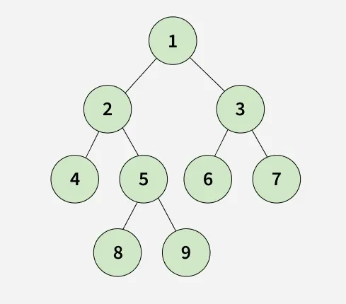
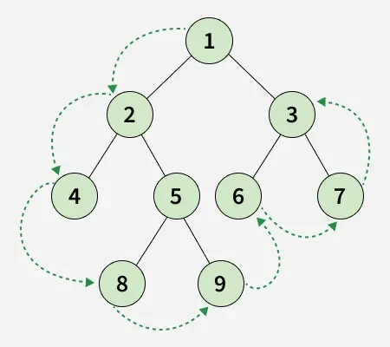
Visualization
Root → Left Boundary → Leaves → Right Boundary
Input :
Explanation:
Output : [1, 2, 4, 8, 9, 6, 7, 3]

Slide 6
Algorithm/Logic
Print Root Node (if not null).
Print Left Boundary: Traverse down the left side until reaching leaf nodes.
Print All Leaf Nodes: Perform an inorder traversal to print every leaf node.
Print Right Boundary (Bottom to Top): Traverse down the right side, collect nodes, and print them in reverse order.
Combine all results to form the boundary traversal sequence.

Slide 7
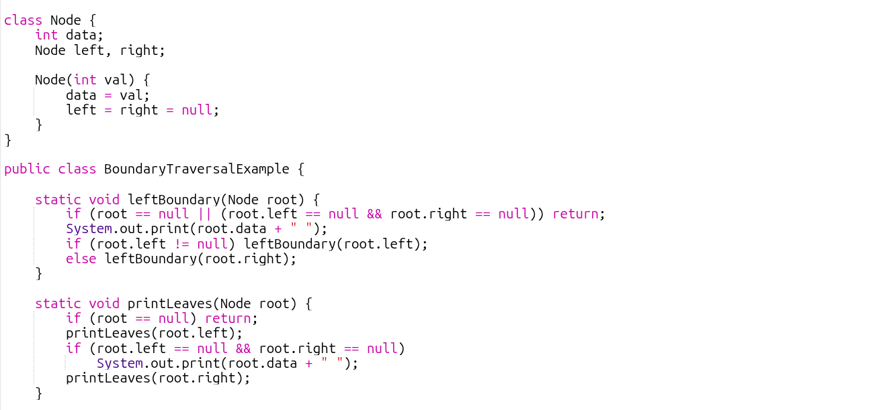
Code Implementation

Slide 8
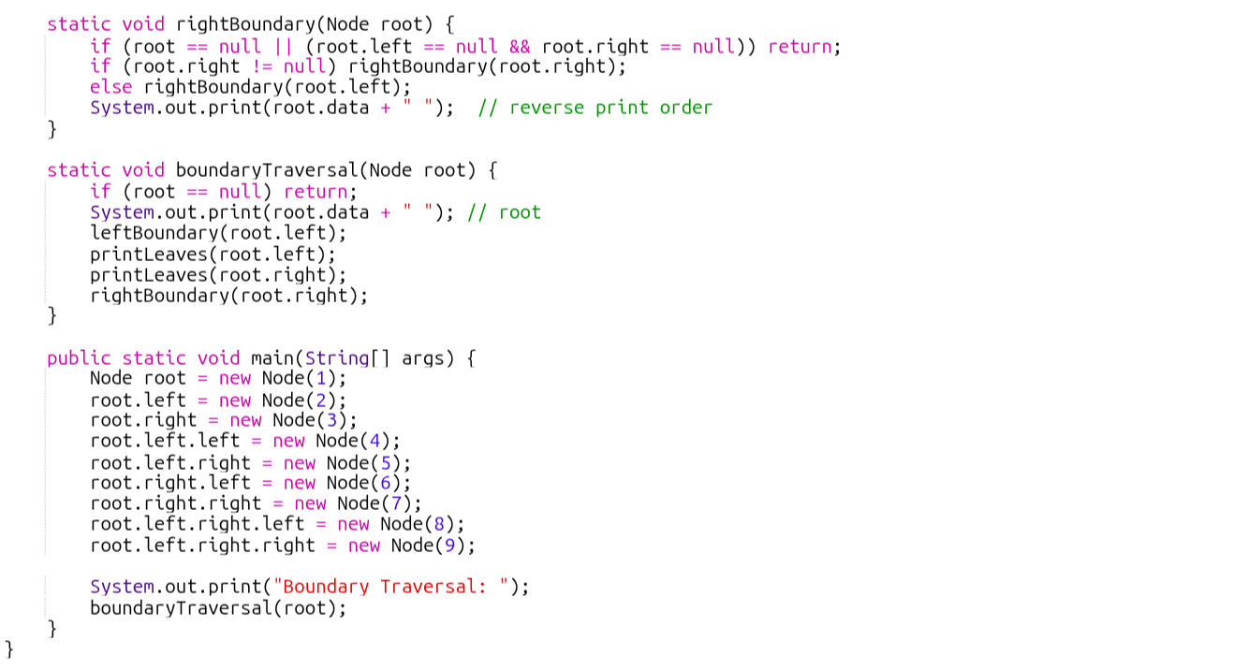

Slide 9

Output :

Slide 10
Time & Space Complexity
Operation | Time Complexity | Space Complexity | Explanation
Boundary Traversal | O(n) | O(h) | Each node is visited once; recursion depth = tree height (h).

Slide 11
Summary
Boundary Traversal helps extract the outermost visible nodes of a tree.
It combines left boundary, leaf nodes, and right boundary.
Time Complexity: O(n), as all nodes are visited once.
Useful in visual rendering, map boundaries, and tree shape analysis.

Slide 12
Practice Questions:
Sum of Left Leaves — LeetCode #404
🔗 https://leetcode.com/problems/sum-of-left-leaves/ Difficulty: Easy
Concept: Traverse the tree and compute the sum of all left leaf nodes.
Why Practice: Improves leaf detection logic. Boundary traversal requires correctly identifying and handling leaf nodes.

Slide 13
Practice Questions:
2. Maximum Width of Binary Tree — LeetCode #662
🔗 https://leetcode.com/problems/maximum-width-of-binary-tree/ Difficulty: Medium
Concept: Determine the maximum width among all levels of the binary tree.
Why Practice: Enhances understanding of extreme left and right nodes per level. Strengthens structural reasoning required for boundary problems.

Slide 14
Practice Questions:
3. Find Bottom Left Tree Value — LeetCode #513
🔗 https://leetcode.com/problems/find-bottom-left-tree-value/ Difficulty: Medium
Concept: Return the leftmost value in the last row of the binary tree.
Why Practice: Strengthens understanding of level-based traversal. Improves bottom-up thinking similar to repeatedly collecting leaves. Helps build intuition for boundary and extreme-node problems.

Slide 15
Thanks

